Slide 1
Models results on hyper-spectral image and thermal image from corn field on ‘Newe Yaar’ (30.09.25_

Slide 2
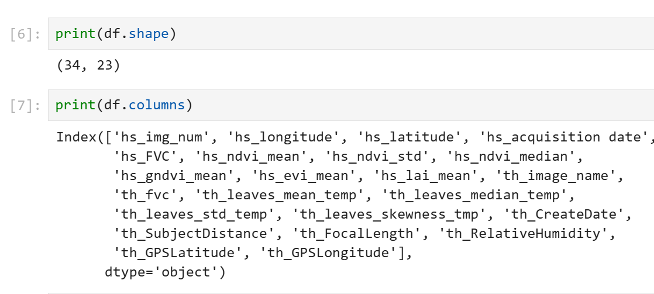
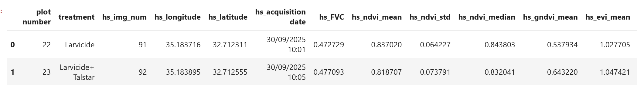
Dataset-preview

Slide 3
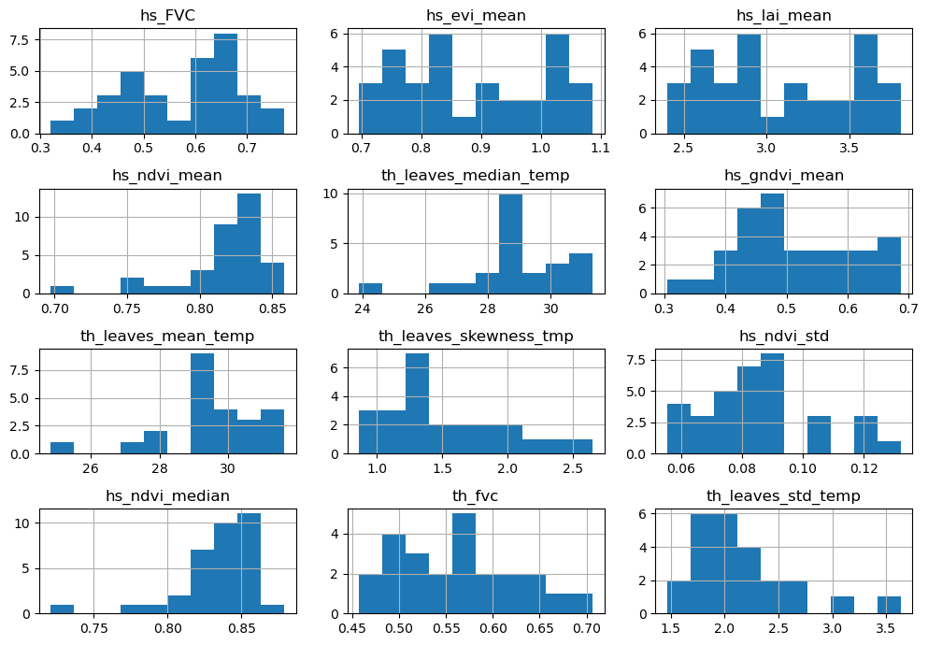

Slide 4
Classification –task
There are four different treatments:
Larvicide (0)
Larvicide +Talstar (1)
Larvicide + Lannate (2)
Larvicide +Talstar + Lannate (3)
The classification task is to classify the kind of treatment by vegetation indices and thermal parameters.

Slide 5
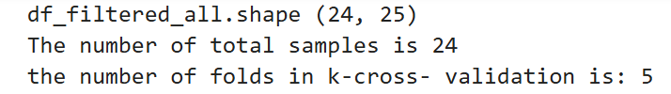
Option 1- eliminate rows that some of the parameters are null (specifically focus in rows that have both hyper-spectral and thermal images)
 | accuracy | features
LogisticRegression | 0.41 | None
DecisionTreeClassifier | 0.16 | [hs_FVC, th_leaves_mean_temp, hs_ndvi_mean]
SVC | 0.41 | None
RandomForestClassifier | 0.29 | [th_leaves_mean_temp, hs_ndvi_mean, hs_FVC]
XGBClassifier | 0.3 | [th_leaves_mean_temp, hs_ndvi_mean, hs_FVC]
GaussianNB | 0.32 | None

Slide 6
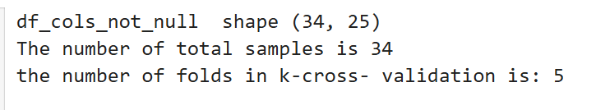
Option 2- eliminate columns that some of the parameters are null (specifically focus on hyper-spectral images)
 | accuracy | features
LogisticRegression | 0.14 | None
DecisionTreeClassifier | 0.18 | [hs_FVC, hs_gndvi_mean, hs_ndvi_mean]
SVC | 0.11 | None
RandomForestClassifier | 0.11 | [hs_FVC, hs_evi_mean, hs_ndvi_mean]
XGBClassifier | 0.2 | [hs_FVC, hs_gndvi_mean, hs_lai_mean]
GaussianNB | 0.26 | None

Slide 7
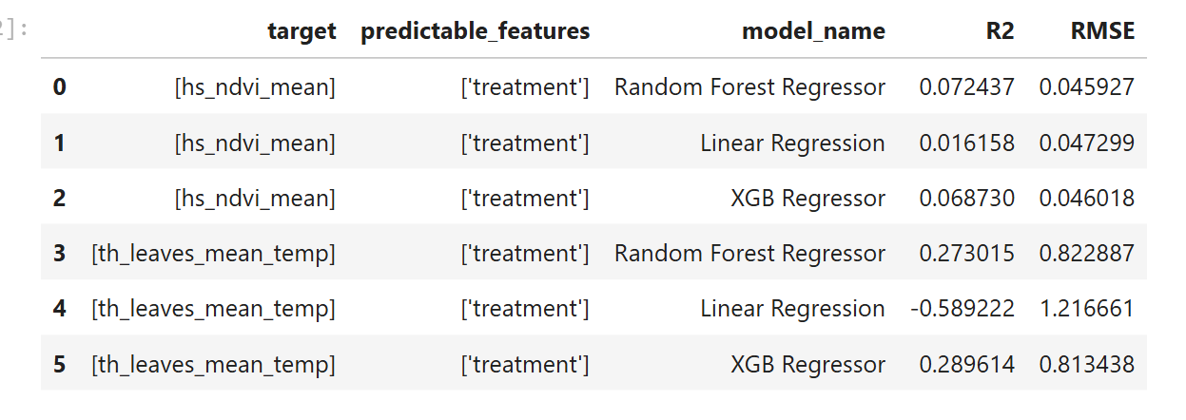
Regression task

